Slide 1
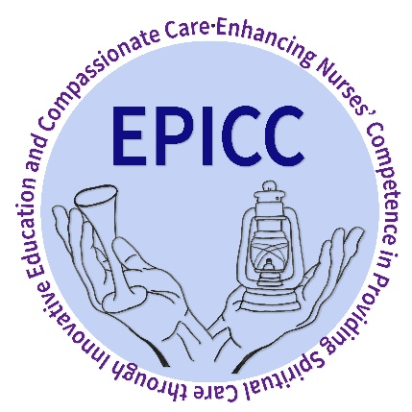


Best Practice In Spiritual Care Education
Finding A Way Forward
Coming together from across Europe to shape the future of spiritual care education and to enhance compassionate care

Slide 2
The impact of spiritual care standards in Nursing
Two examples from the Netherlands
Bart Cusveller PhD b.cusveller@viaa.nl
Aliza Damsma Bakker R.N., MScE, MScE, Phd student a.damsma@viaa.nl
Viaa University of applied science, the Netherlands
EPICC Conference Wednesday 26-09

Slide 3

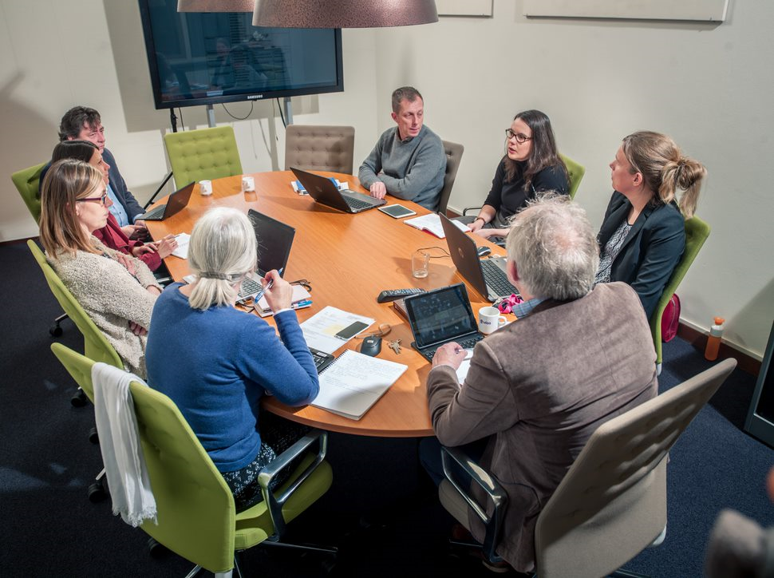
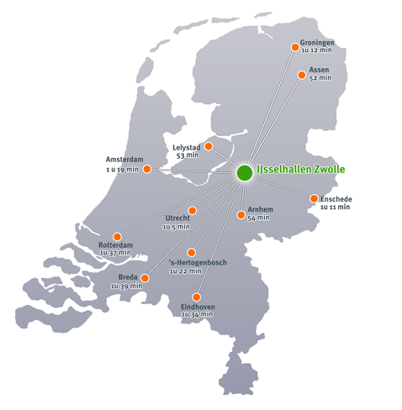
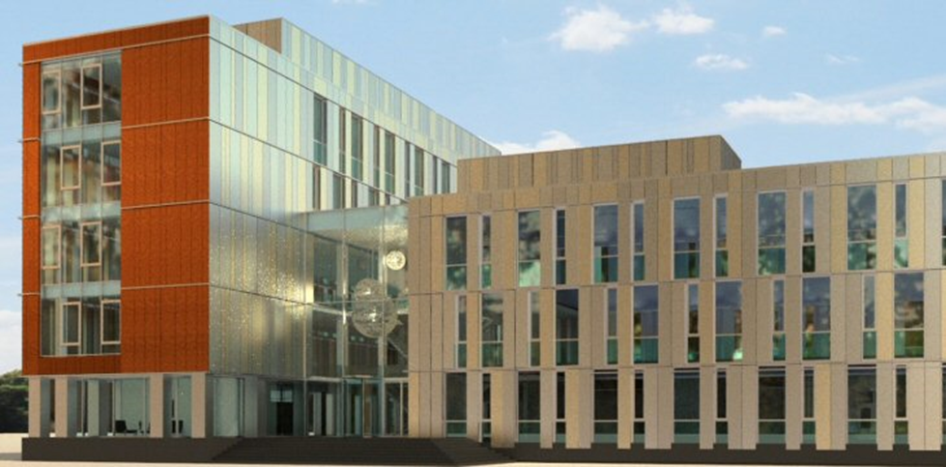
Research Group Spirituality in HealthCare

Slide 4
Content Presentation
Simulation Ethics Lab (immersive learning)
  Dr. Bart Cusveller
Link Nurse program
  Drs. Aliza Damsma Bakker

Slide 5
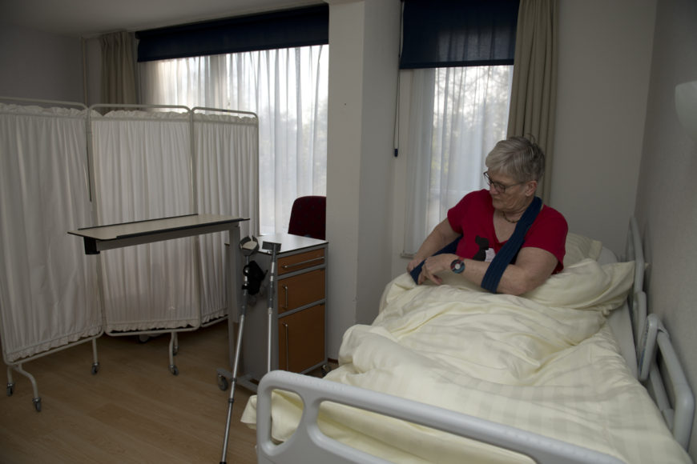
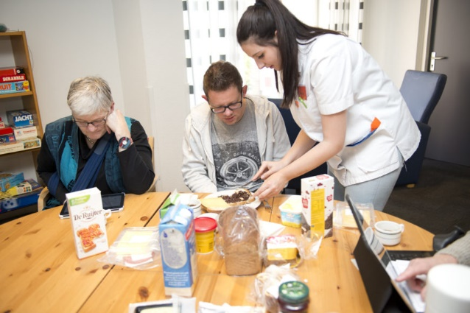
Simulation Ethics Lab
The inspiration: immersive learning
  Care at home, more autonomy, more technology, multidisciplinary
  More sensitive, empathic, responsive, collaborative attitude
  What does it mean for the care receiver to be care receiver?
The cooperation: education, health care organisations
  New forms of learning: suppose it was you?
  Bringing student and experienced nurses together
  Creating a real 'lived experience' for all

Slide 6
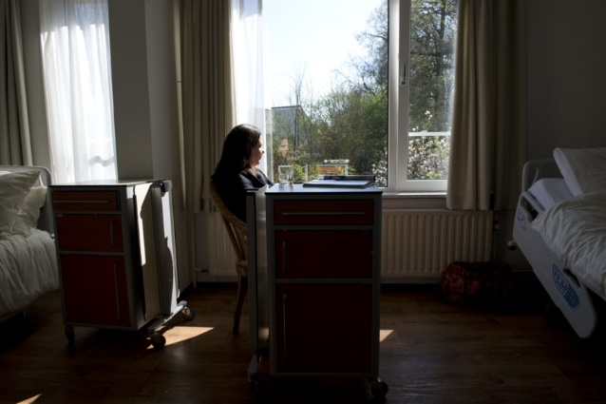
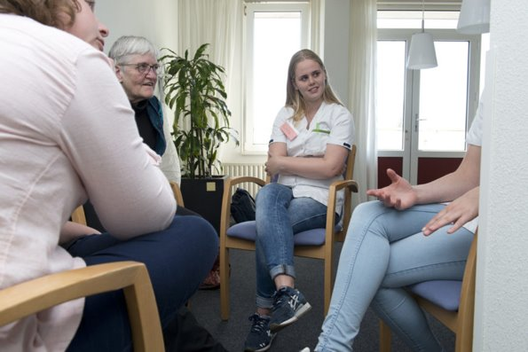
Simulation Ethics Lab
The learning experience: reflective learning
  Simulated unit of residential facility
  Small group of students in care role
  Small group of participants in patient roles
  Feedback and reflection by trainers
A few findings: an eye-opener
  Students and participants become aware of loneliness, dependency and vulnerability
  Participants are generally more impressed and positive than students
  Students find it difficult to come prepared, make contact and change behaviour
  Attentiveness to meaning and personal experience require more education and experience

Slide 7
The Link Nurse Program
The context: a hospital with a strong Christian identity
Declaring the year of spirituality
E-learning to practice and gain knowledge
Training course for one or two nurses on every ward
Training sessions for all nurses
Conferences to connect, share and inspire
Follow with research (Competencies nurses, experiences patient)

Slide 8
The E-learning
For every nurse, 240 in total
6 modules, 5 for everybody, the 6th for the link nurses
  Based on Person, Practice and Perspective model (van Leeuwen).
  Examples: Mount Vernon questions, focus on own care category, interventions
Practical assignment for every module, knowledge test to complete course
  On the ward, time to practice. Buddy to share.

Slide 9
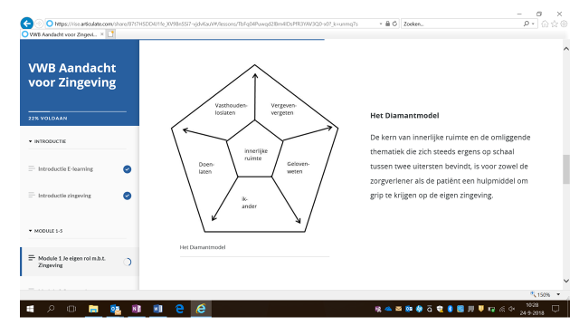
ADD TITLE

Slide 10
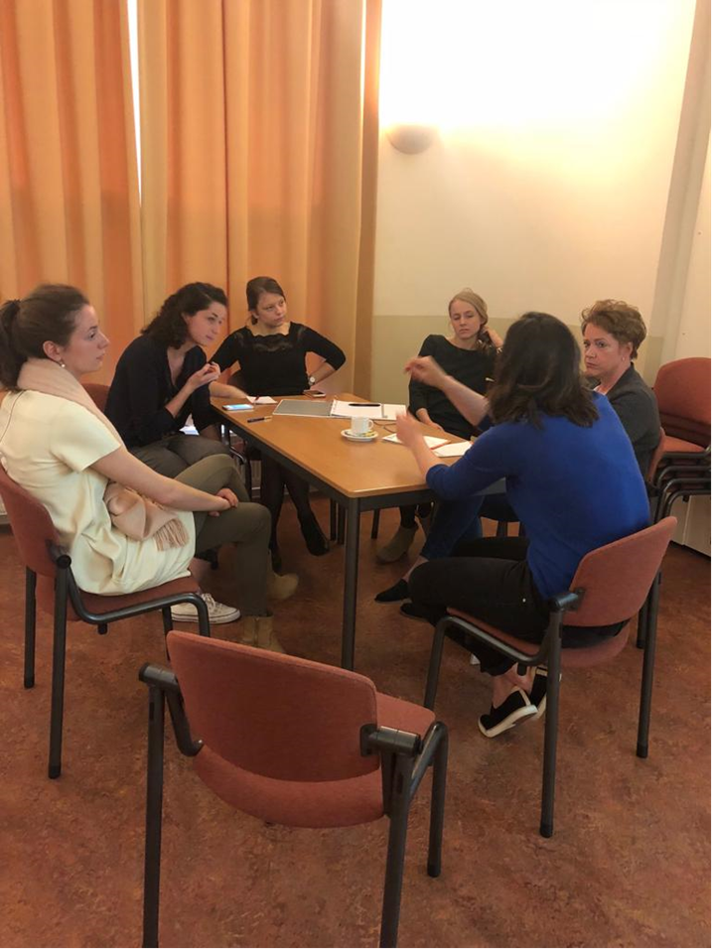
Training courses
Two for all nurses, in small groups
  Own spirituality
  Spirituality of patients/clients
  Spirituality in the nursing process
Two for the link nurses, two per ward
  From SWOT to Start
  Resistance, change management and
  moral council

Slide 11
What’s next?
Interest for the e-learning
Interest for work conferences/ workshops ‘Spirituality in the nursing process’
Development of Minor (30 ECTS) ‘Link Nurse Spirituality’
…

Slide 12
Conclusion
Question?
Thank you for your attention!

