Slide 1

Dr. Joke Lemiengre
EPICC meetings Malta, Reflections from Belgium

Slide 2
Facts and Figures about Ba Nursing
1410 students
80% female students
64 FTE employees
2 campuses in Leuven and Limburg

Slide 3
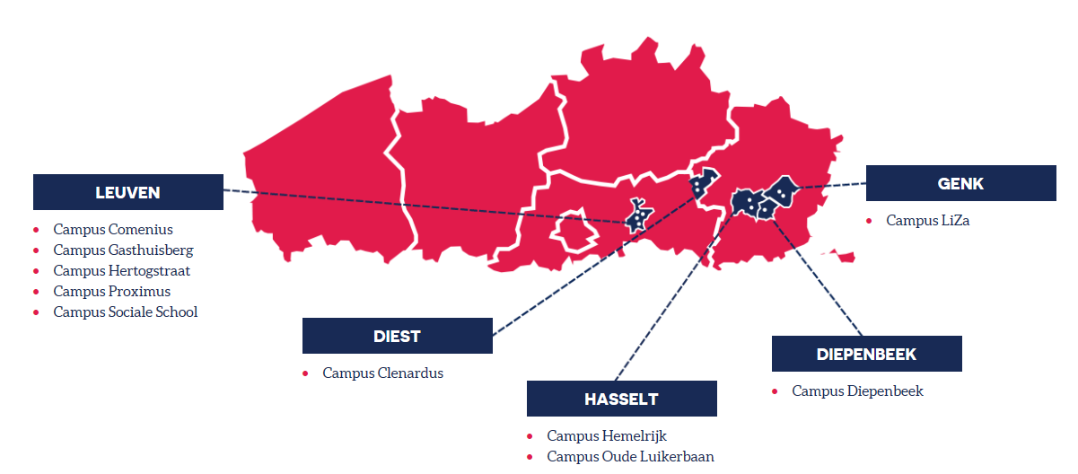
UCLL, nursing on 2 campuses

Slide 4
Program 240 ECTS
Year | Objectives | Internship
1 | Fundamentals: general knowledge, attitudes and skills | 4 weeks
2 / 3 | 6 * different domains (5 weeks) Clustering of domains: Med/ surg 1 (phase 2) Med/ surg 2 (phase 3) Pediatrics and mother & child Mental health care Elderly care Primary care For each domain: First theory and then internship 1 Elective internship (4 weeks) | 30 weeks 6 * 5 weeks 4 weeks
4 | 2 * Specialization in domains (11 weeks) | 22 weeks 2 * 11 weeks

Slide 5

Headlines each module
  Specific accents of nursing at UC Leuven-Limburg
Clinical reasoning
Evidence-based thinking and acting – evidence based education (integration of research, education and practice)
Nursing entrepreneurship
Prevention – patient self management/empowerment
Written and oral communication
Patient safety
Coordination of care

Slide 6

Overarching themes
Thematic quality assurance
ICOM’s: international competences
  1. Personal Growth
  2. Intercultural Competence
  3. Language Skills
  4. Global Engagement
  5. International Disciplinary Learning
Bachelor proof
Inter Professional Education
Notes:
http://www.internationalecompetenties.be/en/
Naast programma specifieke opleidingsonderdelen zijn er een aantal overkoepelende en opleiding overstijgende thema's die hogeschoolbreed worden uitgerold

Slide 7
Objectives:
To start the discussion on spiritual care competences within the nursing curriculum => sensitization & discussion
(Level of Association of the University Colleges connected with the University of Leuven)
2. Using the standard, to check teaching objectives and activities on spiritual care within teaching activities
(Campus level)

Slide 8

1. Dialovo
    Flemish online platform for teachers in nursing education within the association of the University of Leuven (5 UC with +/- 13 campuses Flanders-wide)
    Meeting steering group: Oral presentation about the EPICC Standard with discussion
    Article about the EPICC Standard
    The article was send to all participating UC of nursing with the request to write a response on the article. (April 18)
    Three responses were received. (May 18)
    The article, together with the responses were published in the end of June 18

Slide 9
Reflections
Neverending conceptual discussion on “spirituality”, whether we should use the concept spirituality or ‘giving meaning’ (zingeving in Dutch).
Spiritual competences:
  Please … keep it simple!
  Differences between teachers with nursing or midwifery background and teachers with mainly theological background:
  Nursing background: Many competences are basic nursing competences which are ‘conditions’ for spiritual care (skills & attitudes level); is it possible to focus on the ‘specific’ competences (3,7,8,9)?
  Theological background: Most important issue is that all nurses should be able to care and listen to what is at stake for the patient; all the rest is work for experts, nurses should be able to work together with pastors
Notes:
Some colleagues are convinced that it is better to use ‘spirituality’ while others are in favor of using “giving meaning” because of the threshold that many people have with the concept ‘spirituality’

Slide 10
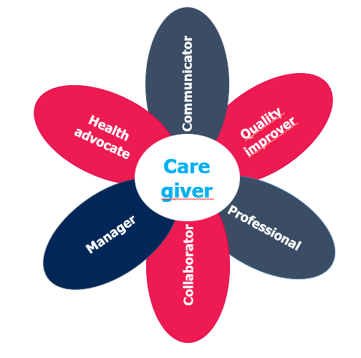
Reflections
Spiritual competences:
Possibility to link
them with the CanMeds?
=> Easier for implementation

Slide 11
Reflections
Succesfull teaching methods
Aim => to increase self awareness (Competence 3)
Using patient narratives in combination with group discussion

Slide 12
What’s next …
New article about EPICC week in Malta
Curriculum team UC Leuven-Limburg
headlines of the modules

Slide 13
Headlines each module
  Specific accents of nursing at UC Leuven-Limburg
Clinical reasoning
Evidence-based thinking and acting – evidence based education (integration of research, education and practice)
Nursing entrepreneurship
Prevention – patient self management/empowerment
Written and oral communication
Patient safety
Coordination of care

Slide 14
Objectives:
To start the discussion on spiritual care competences within the nursing curriculum => sensitization & discussion
(Level of Association of the University Colleges connected with the University of Leuven)
2. Using the standard, to check teaching objectives and activities on spiritual care within teaching activities
(Campus level)

Slide 15
Reflections
I used the standard to check the objectives of the courses “Philosophy, ethics and giving meaning” with those of the standard.
  ‘Knowledge’ level
  Year 1: 1, 3, 5
  Year 2/3: 6, 7, 8, 9
  Year 4: /
Trajectory ‘Personal & professional growth’
  Attitude & skills level
  Year 1: 3, 4
  Year 2/3: 3, 4

Slide 16

Good practices
Using patient narratives in combination with group discussion
“Big” issues + “daily” issues
Refering to the daily world of students, not only ‘care’ (e.g. how do you deal with love sickness)
➔ Working on ‘awareness’

Slide 17
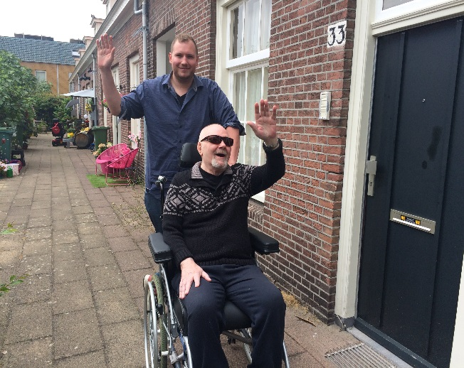
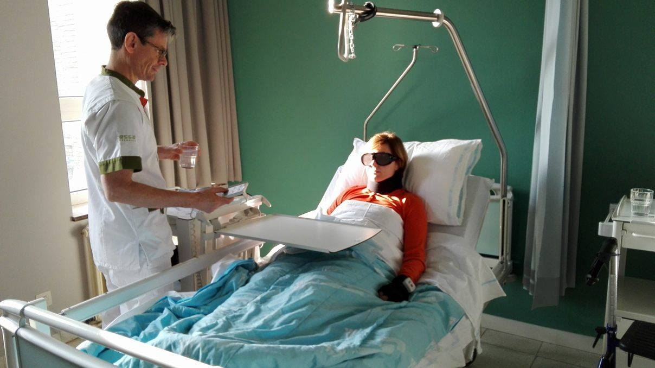
Good practices
(2) Exposure – experiential learning methods in combination with reflection
Year 1: volunteer work
Year 2/3: sTimul

Slide 18
Good practices
(3) Supervision group discussions
Part of personal-professional growth trajectory
Year 1 and 2/3

Slide 19
Challenges
Integration => skills & attitudes
(communication, internships, etc.)
More awarenness about it’s importance among colleague teachers
Actions:
Duo-teaching for nursing case deliberation sessions with students (both teachers have a different background)
Lunch seminars on ethics & giving meaning

Slide 20


Lunch seminars “Food for thought”
12:00 – 13:00, with bread lunch
Organisation: UCLL, HBO5 and hospital
Meet & great ‘teachers’ and ‘nurses’ involved in internships
Practical case:
  Discussion / reflection
  Framework / tools

Slide 21
THANK YOU!
Joke.Lemiengre@ucll.be

