Slide 1
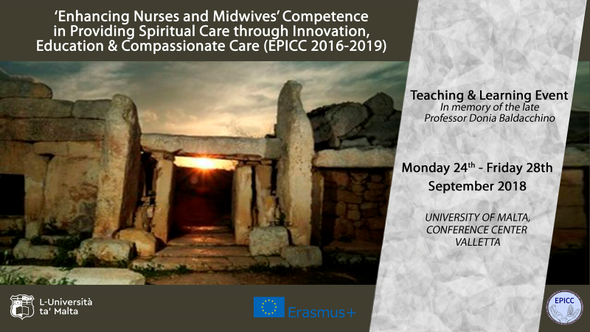

Slide 2


Slide 3
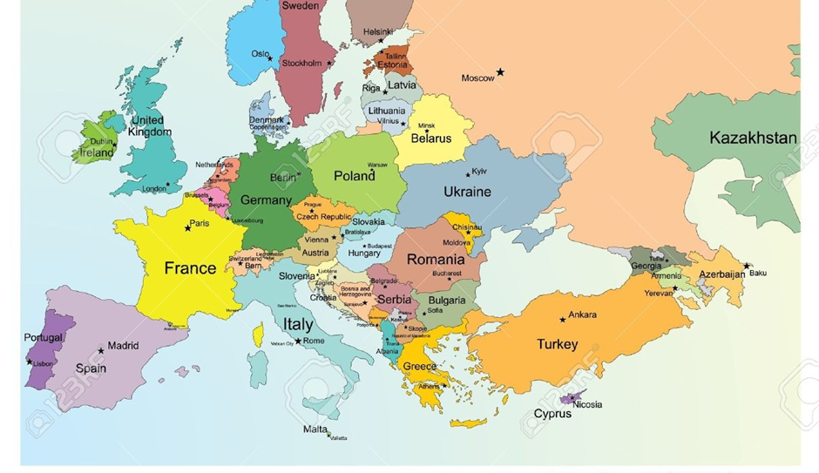
EPICC TEACHING &
LEARNING EVENT
MALTA
2018

Slide 4
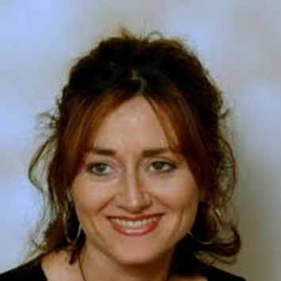
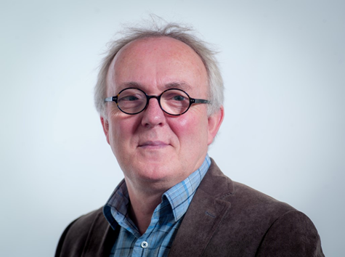
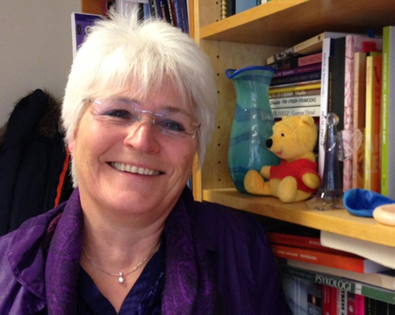
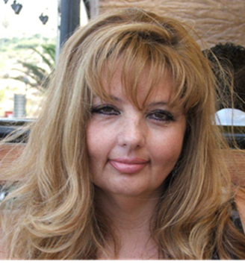
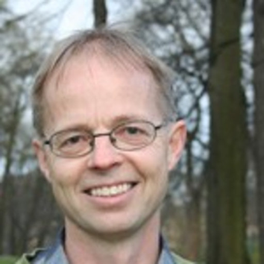
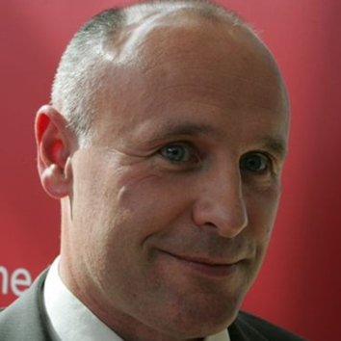
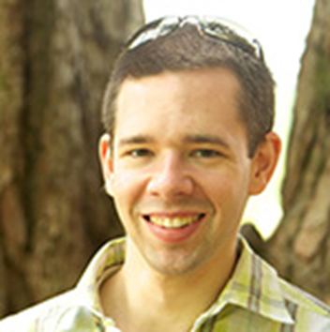
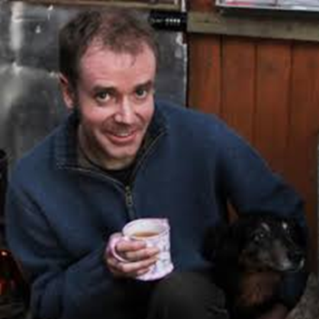
Prof. Rene van Leeuwen Viaa University Zwolle, the Netherlands
Prof. Tove Giske VID University of Science Bergen Norway
Prof. Linda Ross
University of South Wales UK
Dr Josephine Attard
University of Malta
Prof. Tormod Kleiven VID Specialized University Norway
Prof. Wilfred McSherry
University of Staffordshire UK
Mr Adam Boughey
University of Staffordshire UK
Mr Tom Ward University of Staffordshire UK

Slide 5
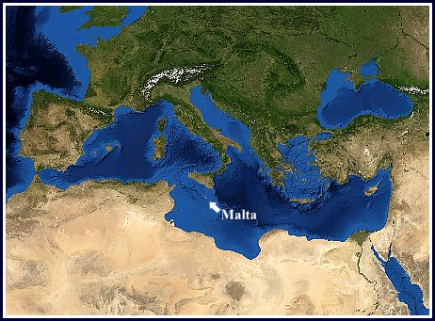
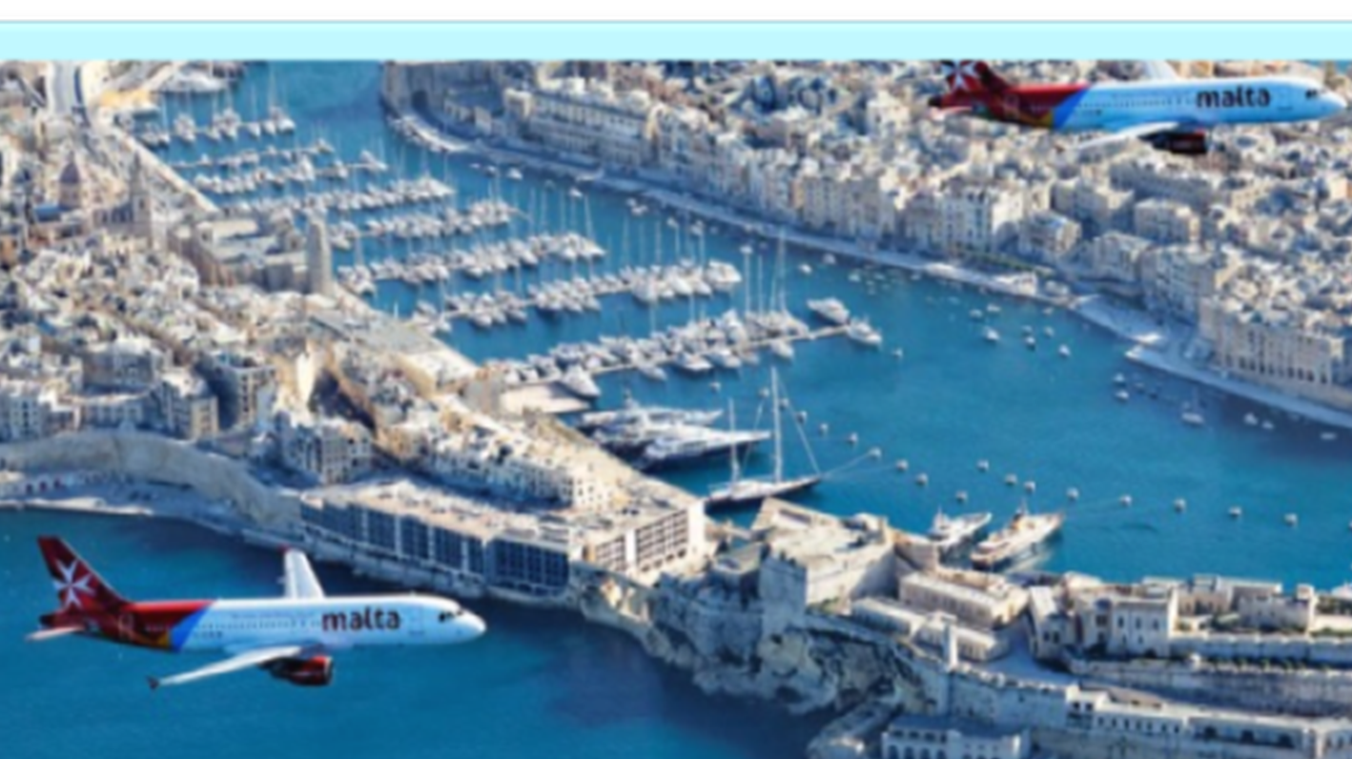
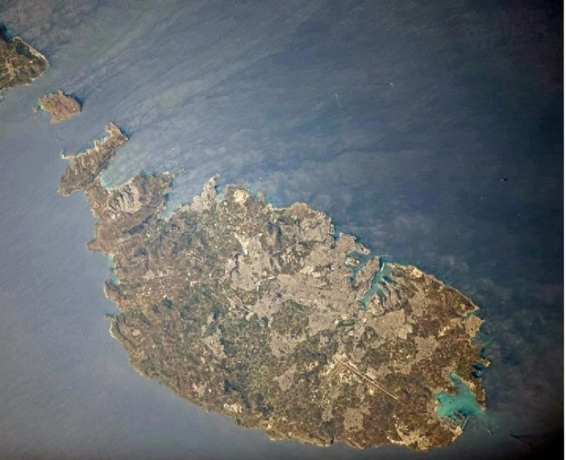
MALTA
Located right in the middle of the Mediterranean, the Maltese Islands located in the passageway between Africa and Europe, 93km south of Sicily and 288km north of Libya promising diverse culture, a dynamic 7,000 years of intriguing history.
With an area of just 316sq km, the Maltese Archipelago is one of the smallest in the world. Yet it is also one of the densest, with over 417,000* residents. Only the three largest islands - Malta, Gozo and Comino - are inhabited.
Capital city-Valletta
Language-Maltese and English (both official)

Slide 6
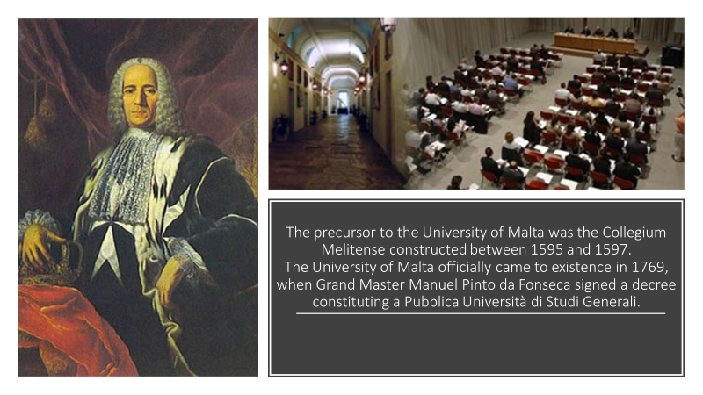

Slide 7
