Slide 1


Education in the field of nursing spiritual care. The results of the international EPICC project
Medical University of Lublin, Poland
Beata Dobrowolska, Joanna Żołnierz
T&L Event 2, In memory of the late Professor Donia Baldacchino
Malta, 2018

Slide 2
EVALUATION TEMPLATE FOR USE OF THE EPICC DRAFT SPIRITUAL CARE EDUCATION STANDARD
What activities did you undertake for the realization of objectives for the use/implementation of the standard in your own education?

Slide 3
What activities did you undertake for the realization of objectives for the use/implementation of the standard in your own education?
Polish Nurses Association
Medical University of Lublin
Polish Association for Spiritual Care in Medicine

Slide 4
What activities did you undertake for the realization of objectives for the use/implementation of the standard in your own education?
Medical University of Lublin
To inform wider community of nurses, academic teachers, nursing students and other professionals about the project aims and outcomes and to start deeper discussion on spiritual care, education and research in nursing

Slide 5
Medical University of Lublin
Discussion was undertaken in a group of teachers and Head of Department of Nursing Development, Faculty of Health Sciences, Medical University of Lublin (prof. Irena Wrońska – Dean of Faculty of Health Sciences) regarding possibilities of inclusion of teaching objectives as prepared in the standard in curricula for undergraduate nursing students
Questions about possibility of implementation of the standard:
– on what level 1st or 2nd?
- in what extend (taking into account number of teaching hours for nursing students on both levels of education), etc.

Slide 6
What activities did you undertake for the realization of objectives for the use/implementation of the standard in your own education?
Medical University of Lublin
2. To translate standard into Polish
3. To map competences included in the standard with teaching effects included in national education standard for undergraduate nursing studies
Standard with competences and learning outcomes are ready to be implemented by other HEIs providing education for undergraduate nursing students in Poland

Slide 7
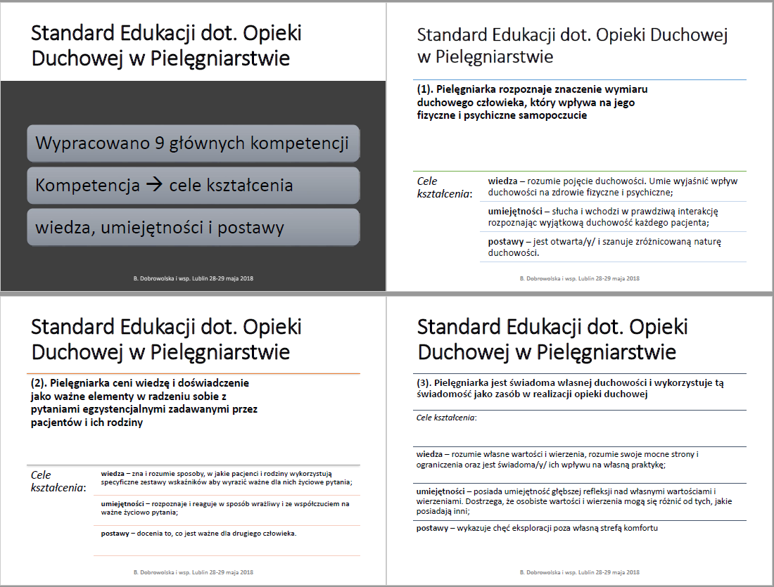
Selected slides from the presentation containing standards translated into Polish
National conference “Medical professions – continuity and change”, Lublin 28-29 May 2018

Slide 8
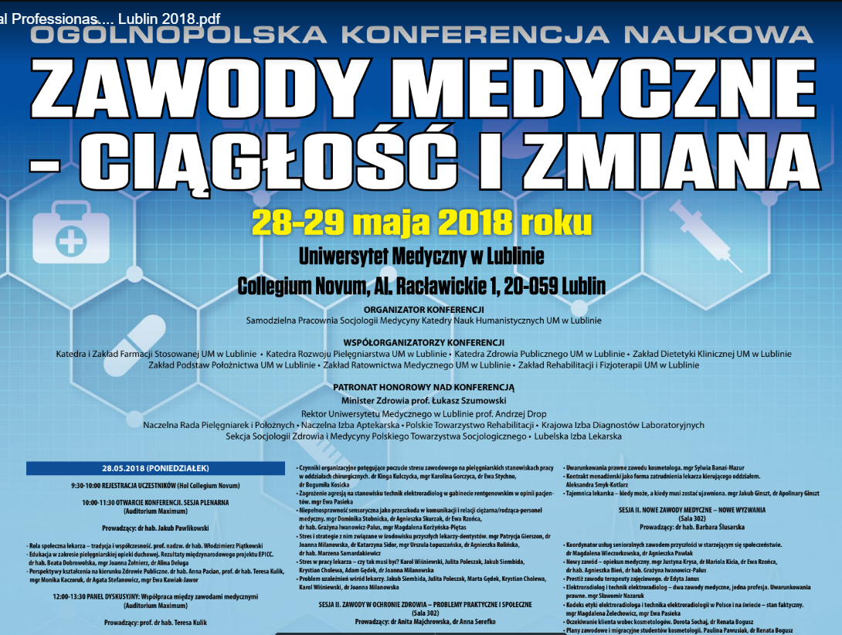
Power Point presentation from the national scientific conference: “Medical professions – continuity and change”, Lublin 28-29 May 2018 (under honorary patronage of Ministry of Health in Poland) – presentation regarding education in the scope of spiritual nursing care and education standard as a result of EPICC project was invited as plenary lecture
http://zawodymedyczne2018.pl/

Slide 9
What activities did you undertake for the realization of objectives for the use/implementation of the standard in your own education?
Medical University of Lublin
4. To implement part of Standard into curricula for undergraduate nursing students in the academic year 2017/2018 and make this change stable.
4 hours were indicated for realization of standard at our University:
seminars (2 hours)
lectures (2 hours) within subject of nursing ethics for 1st year of undergraduate nursing students.

Slide 10
140 students (whole 1st year) participated in teaching-learning process that was organised in the way:
during lecture, students watched the film “Wit” (2 didactic hours)
next week, during 2 hours of seminars they were divided into small groups and reflected on questions prepared by teacher and discussed their answers, than each group presented their reflections in front of all group of students where reflective discussion was also possible.
Evaluation – 2 questions were added to the final written exam, questions were based on case seen in the film “Wit” and were connected with ethical and spiritual aspects of nursing care. Students could obtain additional points to their final grade from this exam.
Medical University of Lublin

Slide 11
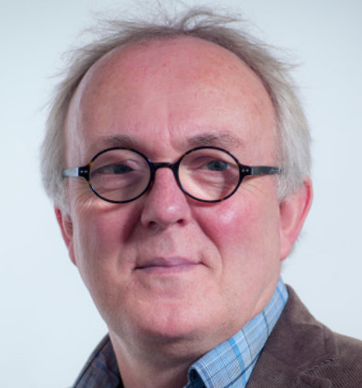
What activities did you undertake for the realization of objectives for the use/implementation of the standard in your own education?
Medical University of Lublin
5. Master thesis is going to be prepared with validation of the Spiritual Care Competency Scale (SCCS) by Rene Leeuwen (author’s approval is obtained) – acceptance of Faculty Board is received, and student is in the process of translation of the scale into Polish
https://www.researchgate.net/profile/Rene_Leeuwen

Slide 12
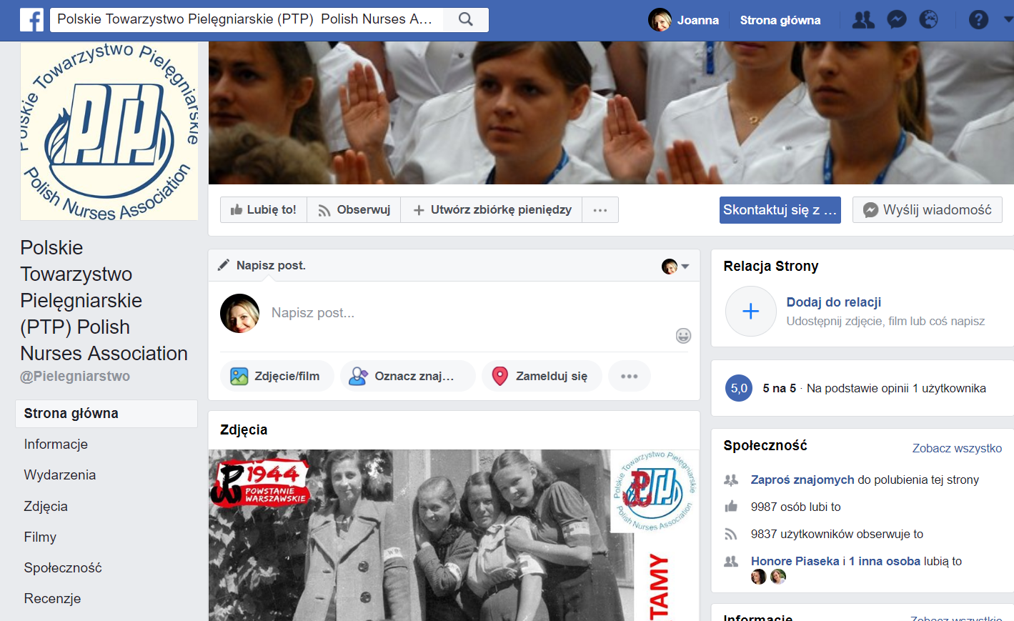
What activities did you undertake for the realization of objectives for the use/implementation of the standard in your own education?
Polish Nurses Association
https://www.facebook.com/Pielegniarstwo/

Slide 13
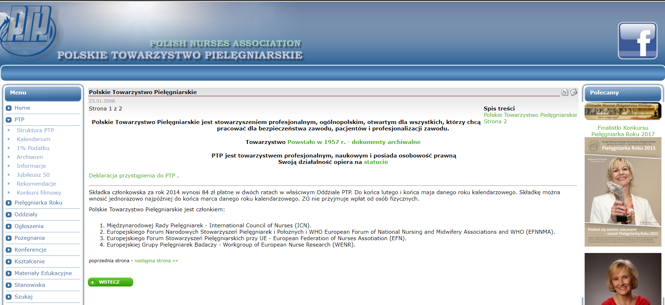
Polish Nurses Association one of the biggest nursing organisation in Poland with power to influence standard of nursing education nationally
Polish Nurses Association
http://www.ptp.na1.pl/index.php?option=com_frontpage&Itemid=1

Slide 14
Application with presentation of the idea of the project and standard of education with 9 competences and teaching objectives was sent to National Congress of Polish Nurses: “Contemporary nursing – dynamics of changes and a call for action”, Kielce 13-15 September 2018 (congress is organised every second year by the Polish Nurses Association)
Polish Nurses Association

Slide 15
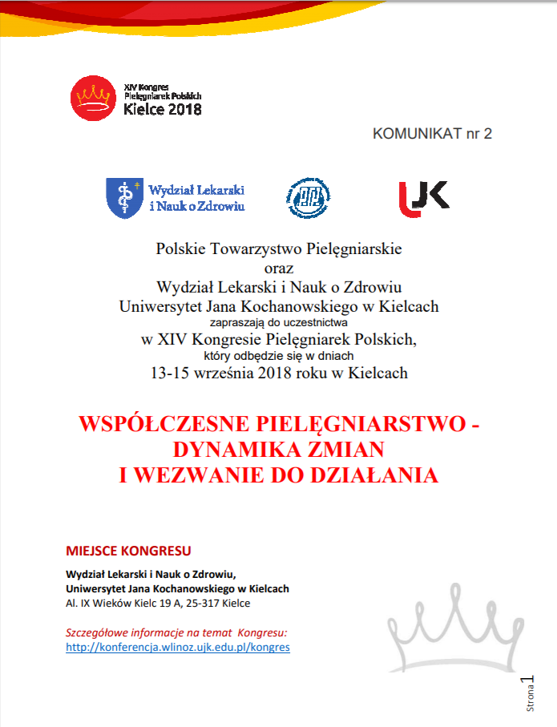
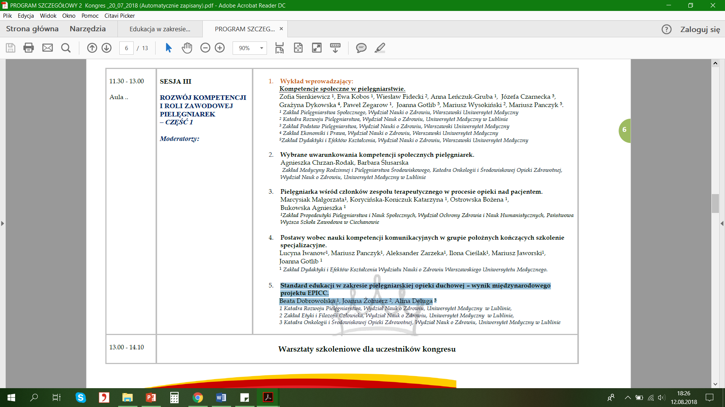
http://wnoz.uwm.edu.pl/sites/default/files/download/201803/kongres_pielegniarek_polskich_2018_komunikat_2_0.pdf

Slide 16
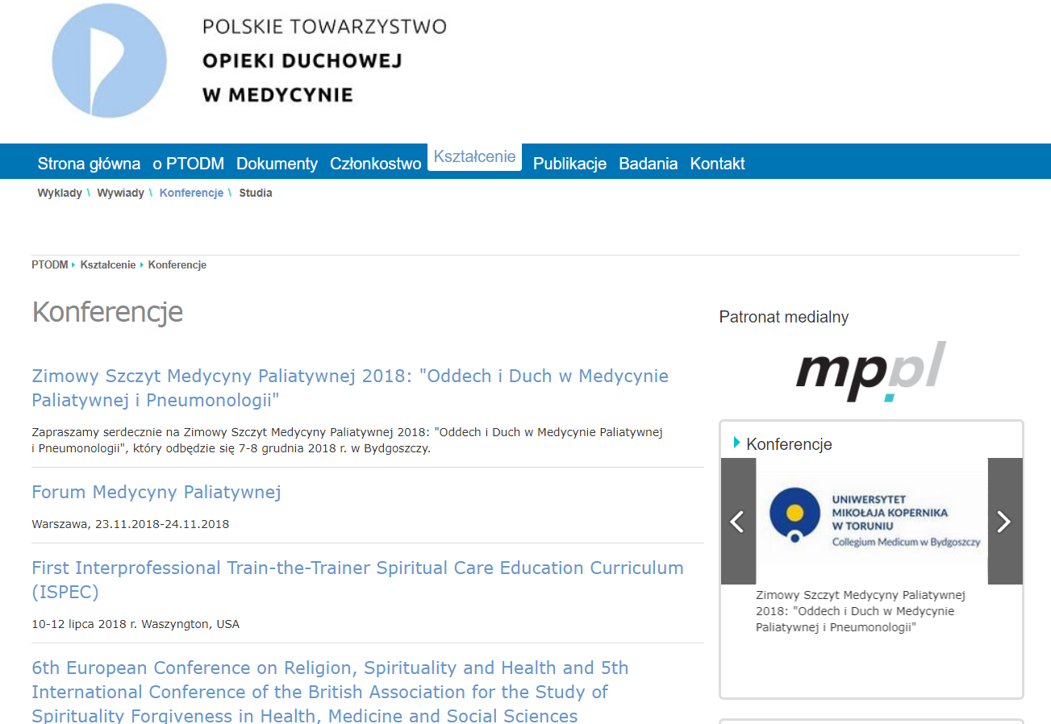
What activities did you undertake for the realization of objectives for the use/implementation of the standard in your own education?
Polish Association for Spiritual Care in Medicine
http://ptodm.org.pl/ksztalcenie/konferencje

Slide 17
The mission of the organization:
"Integrating and representing the environment of people interested in spiritual care in medicine, provided to the sick, the disabled and their families, striving to provide them with high quality of care and supporting the development of scientific research and promotion of knowledge in this field."
Polish Association for Spiritual Care in Medicine
Polish Association for Spiritual Care in Medicine
http://ptodm.org.pl/o-ptodm/misja

Slide 18
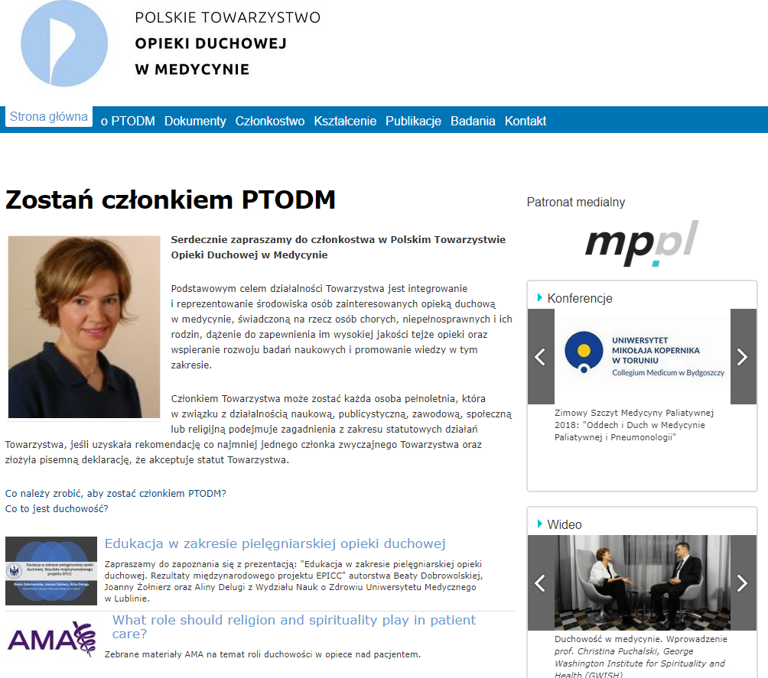
Information prepared for the website of the Polish Association for Spiritual Care in Medicine with Polish version of the Standard
(Home page)
What activities did you undertake for the realization of objectives for the use/implementation of the standard in your own education?
http://ptodm.org.pl/

Slide 19
Conference together?

Slide 20
References and pictures: https://www.facebook.com/Pielegniarstwo/photos/a.207355969288073.53977.207351262621877/207357945954542/?type=1&theater http://www.umlub.pl/en/ http://umlub.pl/uczelnia/kontakt/ http://ptodm.org.pl/ https://www.facebook.com/Pielegniarstwo/ http://www.ptp.na1.pl/index.php?option=com_frontpage&Itemid=1 http://wnoz.uwm.edu.pl/sites/default/files/download/201803/kongres_pielegniarek_polskich_2018_komunikat_2_0.pdf http://ptodm.org.pl/ksztalcenie/konferencje https://www.researchgate.net/profile/Rene_Leeuwen http://zawodymedyczne2018.pl/ https://www.facebook.com/kreatywniedlazdrowia/posts/1404941772938987 https://www.facebook.com/photo.php?fbid=10213212865423557&set=a.1553616567695.78473.1453611106&type=3&theater https://content.sciendo.com/view/journals/pjph/pjph-overview.xml https://www.facebook.com/podkarpackie.przestrzen.otwarta/photos/a.221869367856233.55858.212326562143847/1796747153701772/?type=3&theater http://ptodm.org.pl/o-ptodm/misja

Slide 21
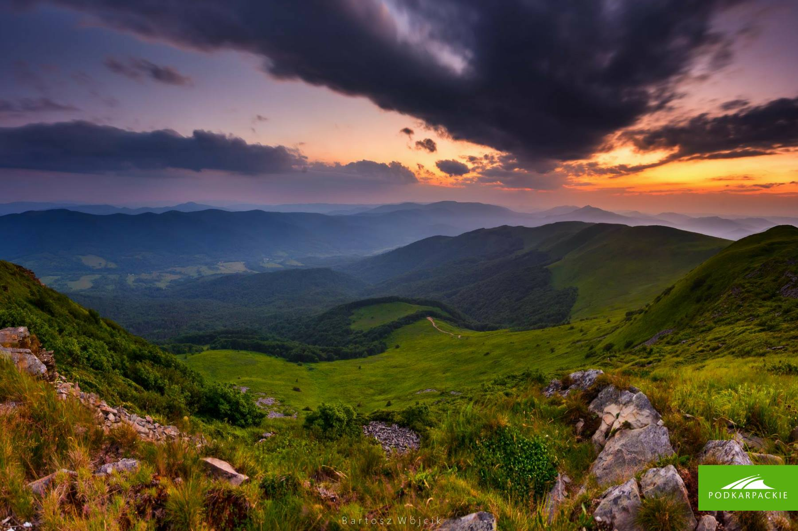
https://www.facebook.com/podkarpackie.przestrzen.otwarta/photos/a.221869367856233.55858.212326562143847/1796747153701772/?type=3&theater
Sunset in the Bieszczady Mountains, in Podkarpacie - my Region!
Thank you! ☺

